Slide 1
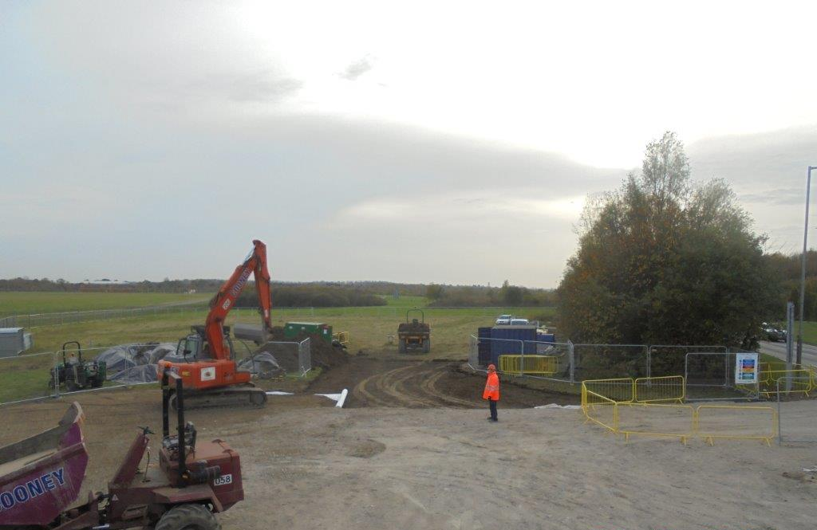
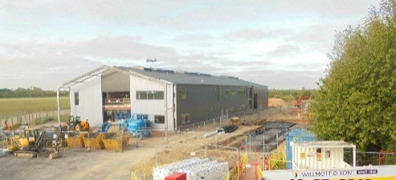
Autumn 2017
Summer 2018

Slide 2
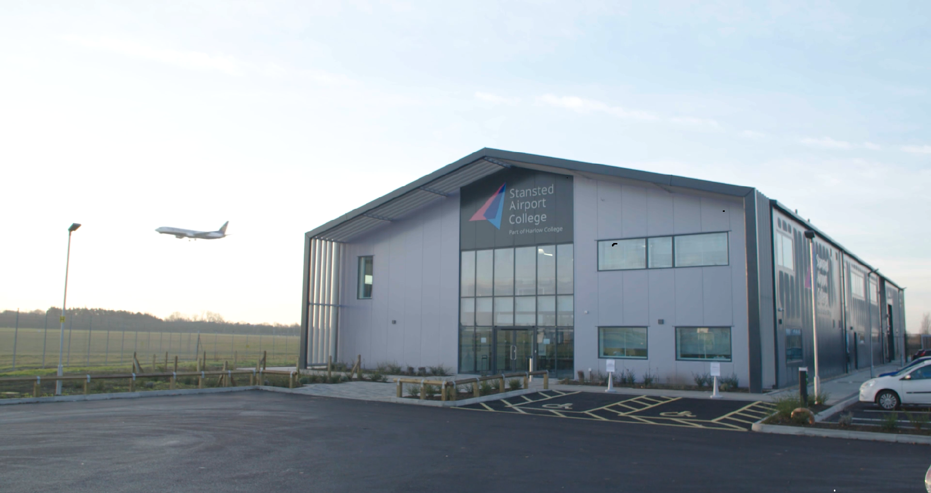

Slide 3
https://vimeo.com/inthedarkproductions/review/325653669/11b6300c31

Slide 4
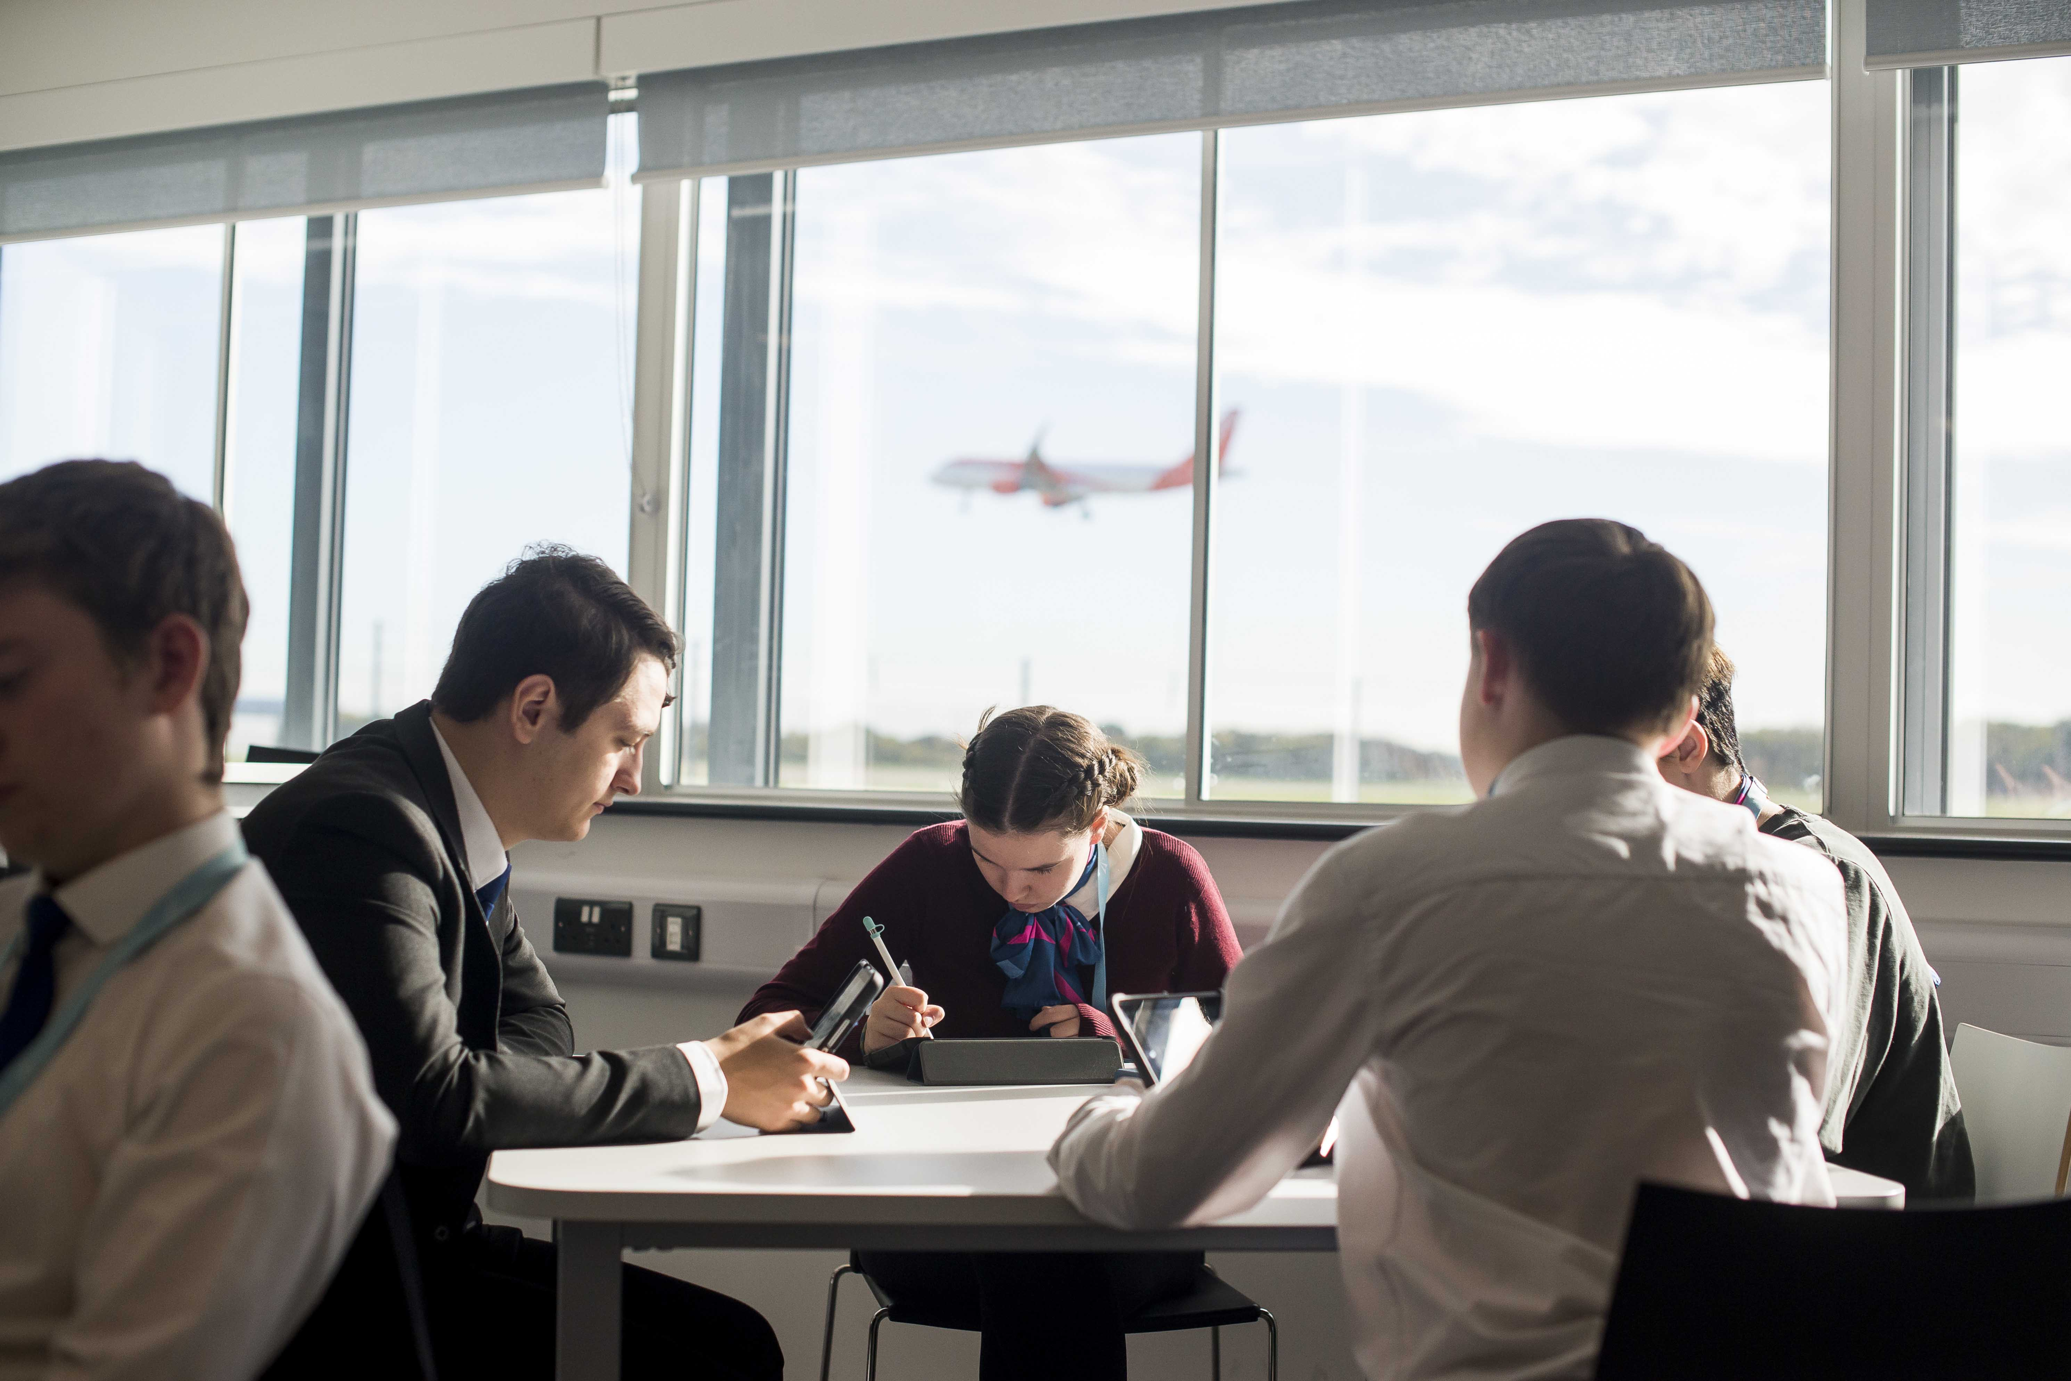

Slide 5
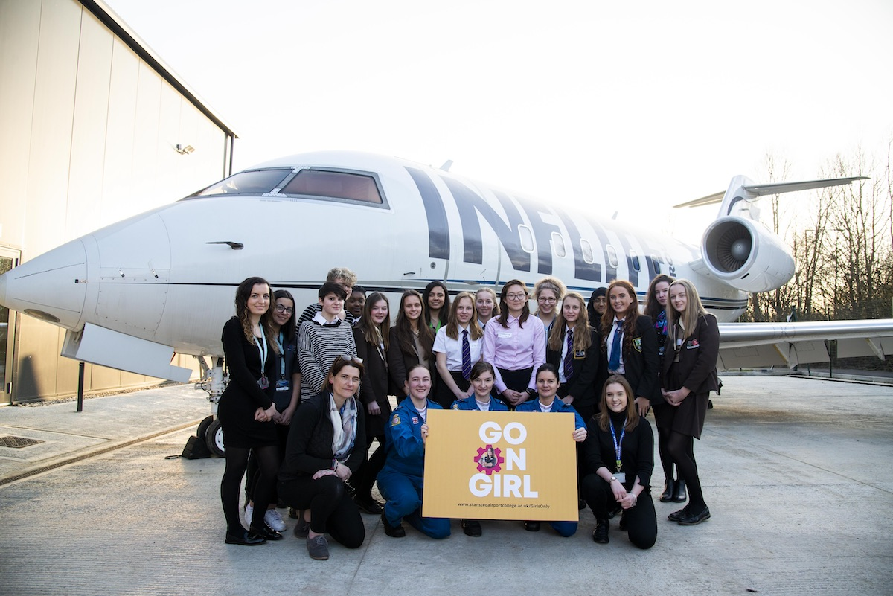

Slide 6
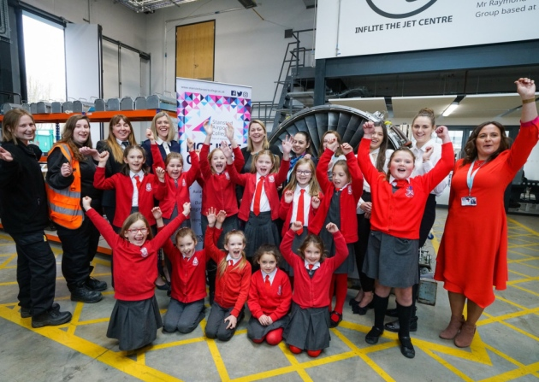

Slide 7
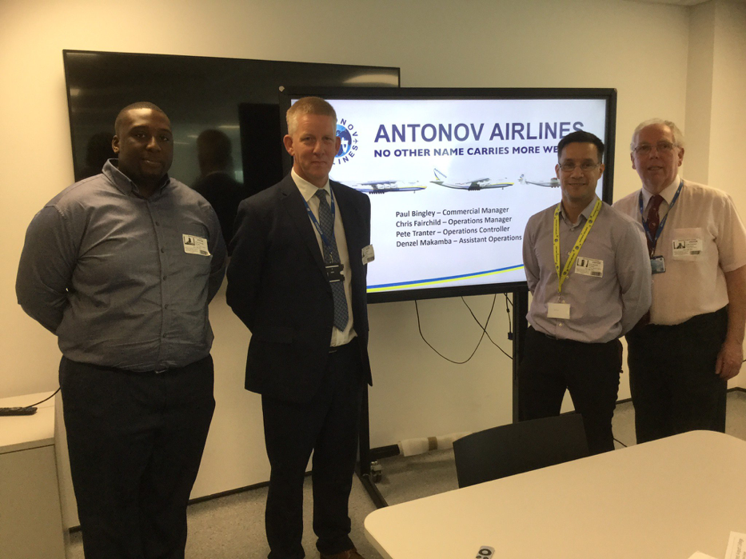

Slide 8
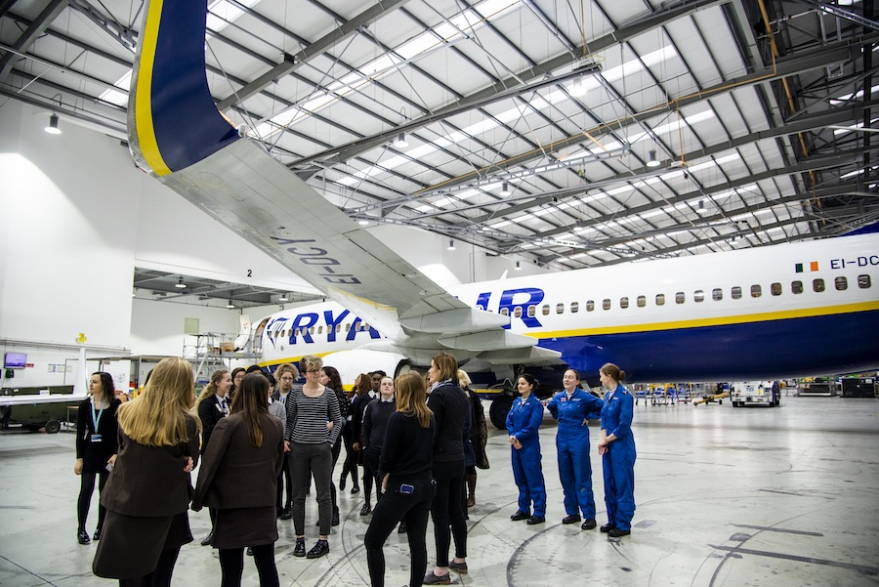

Slide 9
Year 1 activity (Sept 2018 – July 2019)
16-19 Full time learners | 278
Adults | 389
Apprenticeships | 27
Jobs | 98
Yr 1 Achievement rate (Predicted) | 96%
https://youtu.be/IKhVW9IoFOA

Slide 10
Year 2 planning (Sept 2019 – July 2020)
Fulltime applications to date | 511
Predicted Apprenticeships | 70
Progressing | 222
Adult learner target | 300
Job outcomes | 500
Current building capacity | 530

Slide 11
Thank you
Will Allanson - Deputy Principal
Harlow College
wallanson@harlow-college.ac.uk
07824532975

