Slide 1
SELEP Major Projects
26th May 2021

Slide 2
Why MACE?
Build upon the earlier Essex County Council commission to develop a jobs and skills evaluation for the construction sector- we will extend our analysis across the SELEP region and extend the sectors covered at a high level. We will draw upon the conclusions of that report and extend recommendations across the SELEP geographical region and it’s major projects
Current experience in developing Hydrogen and Industrial Decarbonisation Cluster programmes, evaluating how the UK jobs and skills market needs to rise to the challenge of delivering the decarbonised industrial economy target.
Building upon work we have done to support the development of Freeports in Doncaster, Cumbria and in Teeside- understanding the impact customs and tax benefits can have in driving economic growth (and by virtue, creation of new jobs)
Major “Place” regeneration programmes and development and delivery of major infrastructure projects including HS2, A14, A303, Olympics, Pan American Games, Heathrow and Dubai Expo

Slide 3
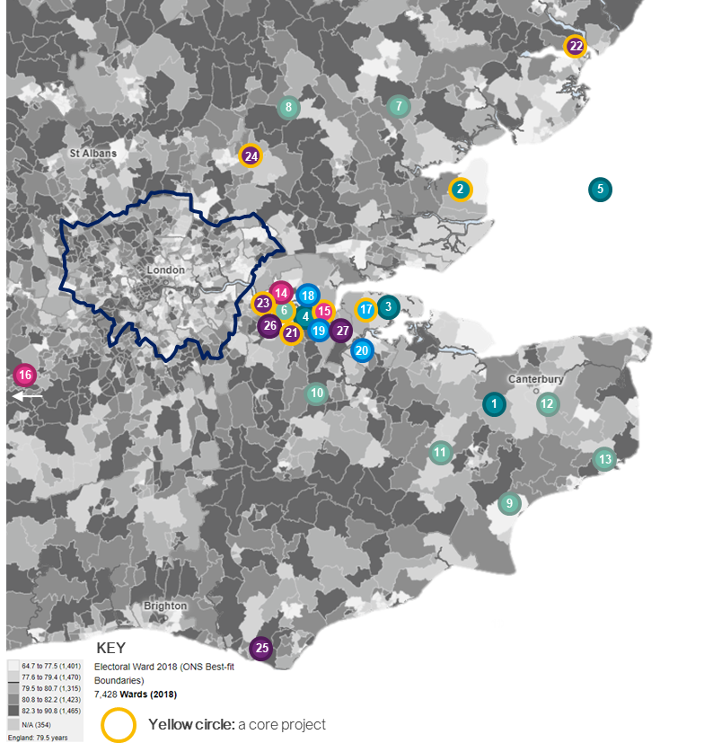
About the commission
Understand what the major projects are in the SE region
Understand the current workforce picture & demographics of the region
Understand the required future workforce requirements
Undertake gap analysis research of the required trained workforce
Develop a series of recommendations needed in order to develop a trained and sustainable workforce in order to meet the project requirements

Slide 4
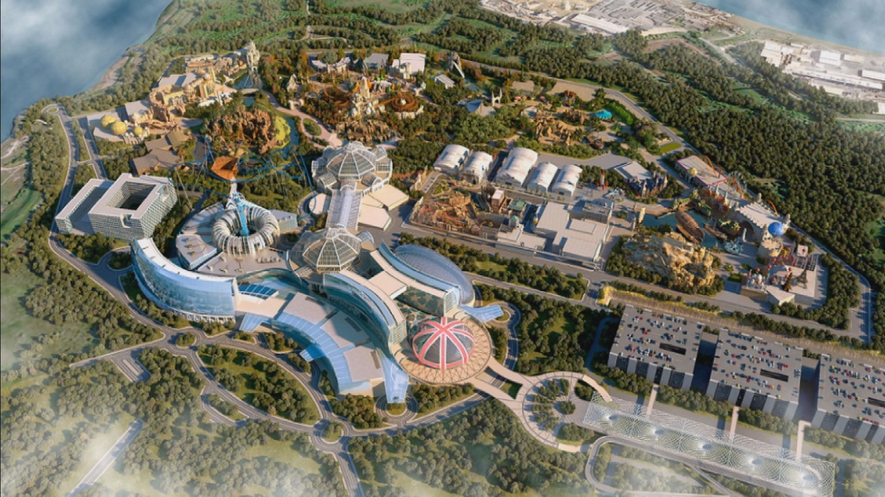
The London Resort
Two theme parks
Water park
Hotels
Shopping centres
Entertainment venues

Slide 5
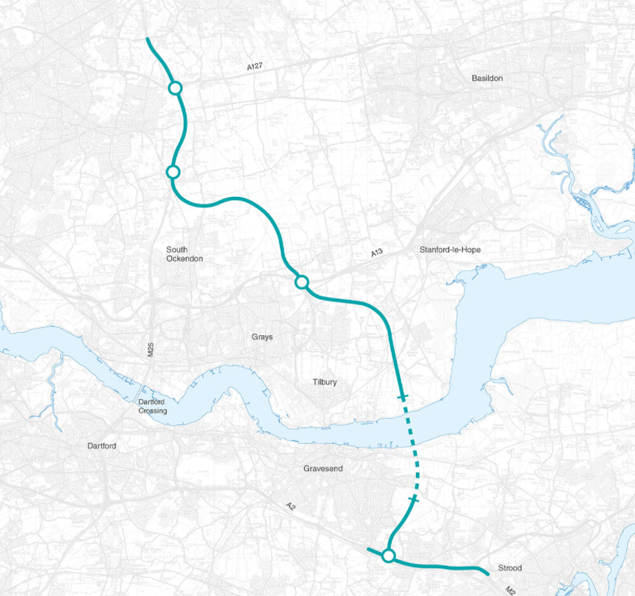
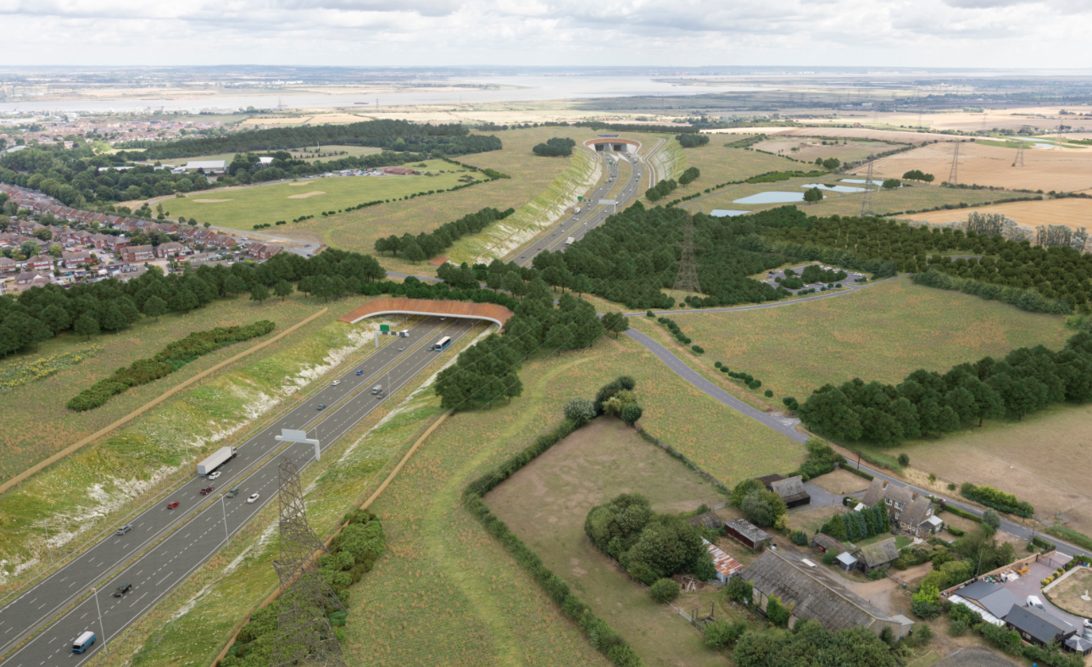
Lower thames crossing
14.3 miles of road, 2.6 miles of tunnel
22,000 jobs during construction

Slide 6
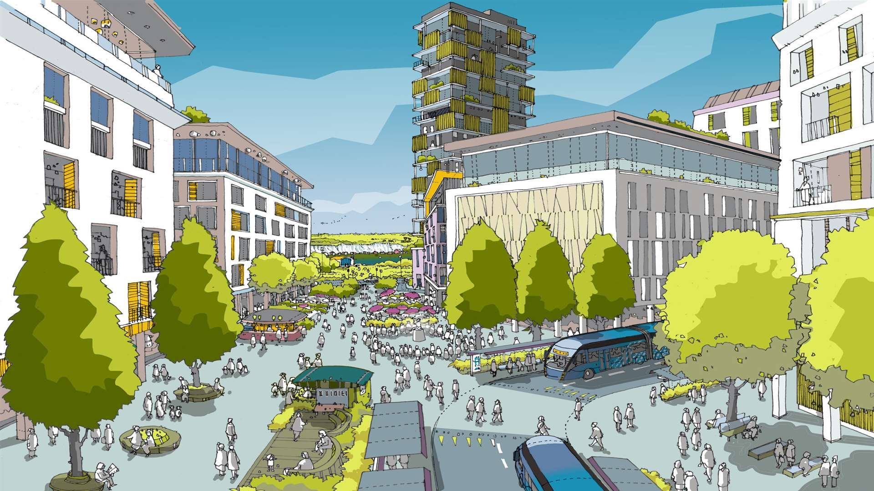
Ebbsfleet Garden City
15,000 high quality new homes
Business
Leisure
Entertainment
Hotels
Restaurants

Slide 7
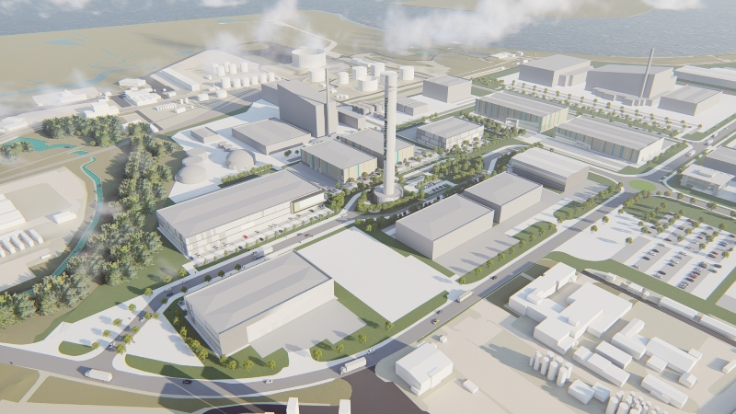
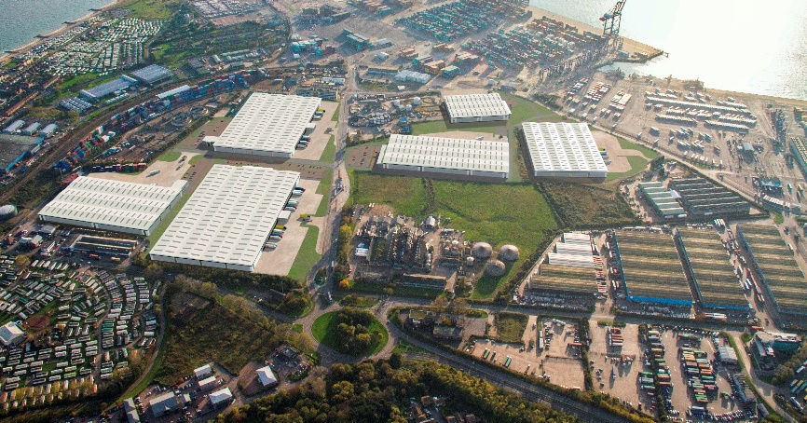
freeports
Thames Estuary
Felixstowe and Harwich
Could create up to 25,000 new jobs in the area
Freeport will unlock £400 million of port investment in deprived areas

Slide 8
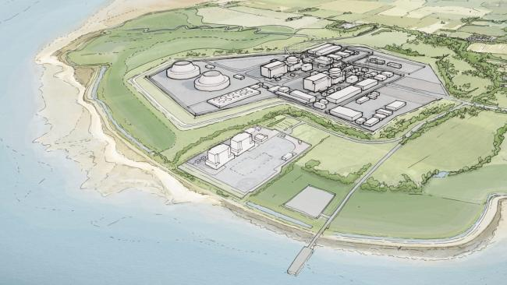
Bradwell B Power station
At least 9,000 jobs during construction; 1200 apprenticeships
900 permanent jobs
Built alongside the decommissioned Bradwell power station

Slide 9
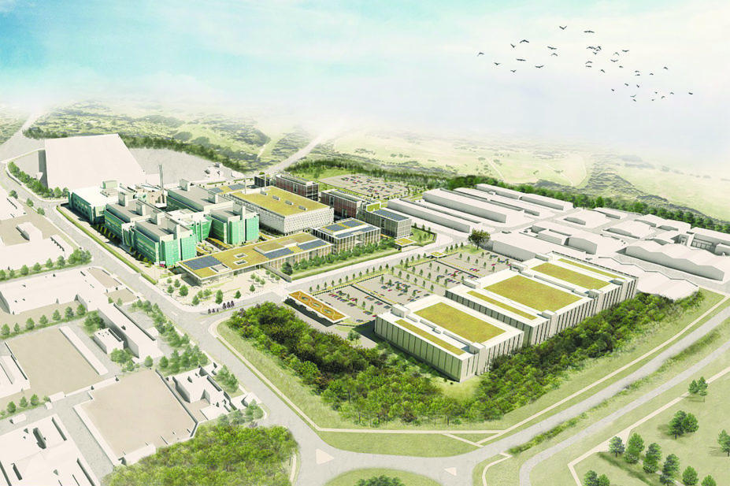
Public Health England (Relocation)
2,750 staff from the Department of Health agency’s current sites, including Porton in Wiltshire, Colindale in north London, and its current central London headquarters
Fully operational in 2024

Slide 10
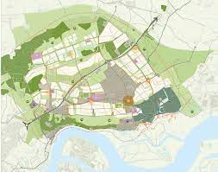
Hoo Peninsula
Transform the area by 2037
12,000 new homes
Rail link
Pedestrian-friendly green infrastructure network

Slide 11
Skills demand modelling methodology
Review each project (circa 8, plus other projects of significance)
Review construction/project value and delivery timescale (pre- construction/construction/operation)
Identify skills sets required at each stage
Use our metrics to assess the estimated job numbers of each type
Produce a desktop Skills Report on each project
Summarise skills required by year (short/medium/long term)
Separated into sub-regions to help facilitate more local skills matching
Produce greater depth of analysis on selected major projects

Slide 12
Skills demand modelling methodology
Diagram below identifies an arbitrary range of projects and range of stages of completion for illustrative purposes to help define our methodology
Accuracy/ understanding of skills need by project delivery organisations
Scale of work to be undertaken by Mace to assess at high level the range and quantum of skills needs per project
 | 10% | 20% | 30% | 40% | 50% | 60% | 70% | 80% | 90% | 100%
Project 1
Project 2
Project 3
Project 4
Project 5
Project 6
Project 7
Project 8

Slide 13
Skills demand modelling methodology
Build Phase Needs | 2021 | 2022 | 2023 | 2024 | 2025 | 2026 | 2027 | 2028 | 2030 | 2031 | 2032
Project 1 Commence/ Complete
Project 2 Commence/ Complete
Project 3 Commence/ Complete
Project 4 Commence/ Complete
Project 5 Commence/ Complete
Project 6 Commence/ Complete
Project 7 Commence/ Complete
Project 8 Commence/ Complete

Slide 14
Skills demand modelling methodology
Operate Phase Needs | 2023 | 2024 | 2025 | 2026 | 2027 | 2028 | 2029 | 2030 | 2031 | 2032 | 2033
Project 1
Project 2
Project 3
Project 4
Project 5
Project 6
Project 7
Project 8

Slide 15
Example: the London resort
2019-2021
Planning
2021- 2024
Construction
2024 -
Operation
Project Management
Architects
Other Consultants
Finance
Engineers
Communications
Admin
HR
Ride technicians
Marketing
Maintenance
IT
Construction Managers
Site supervisor
Operatives
Inspectors
Surveyors
Tradesmen
FM facilities management
Concession workers
Ride technicians
Catering
Retail
Entertainment
Hotel staff
Maintenance

Slide 16
Skills supply
A review of the Skills Analysis and Deep Dive modelling to provide a peer review of forecasting work
Research and engagement with the educational and training establishments that will be critical in creating the skills and matching people to the forecast pipeline of required skills.
A Skills Supply Solution and Strategy for each project/Sub region (broken into sub tasks)

Slide 17
Core Projects Programme
From Planning to operation
 | 2021 | 2022 | 2023 | 2024 | 2025 | 2026 | 2027 | 2028 | 2029 | 2030 | 2031 | 2032 | 2033 | 2034 | 2035 | 2036
Bradwell B
Ebbsfleet Garden City
Felixstowe and Harwich Freeport
Hoo Peninsula
Lower Thames Crossing
Public Health England Relocation
Thames Estuary Freeport
The London Resort
Construction started 2019
Gateway 2 opening
Gateway 1 opening

Slide 18
Preliminary Figures
Included (Core plus some other projects of significants)
Cleve Hill Solar Park, North Kent Coast : £450m – 2021 -2025
Ebbsfleet Garden Village, £5bn : 2021 - 2036
Otterpool Park Garden Town , Folkstone: £2bn: 2023- 2053
Chilmington Garden Village, Ashford, Kent: £1.2bn: 2023- 2043
Mountfield Park Garden City, Canterbury, Kent: £1bn: 2024- 2036
The London Resort, Kent: £800m: 2022- 2025 G1: 2025- 2025 - 2029 G2
Hoo Peninsula, Kent 2023- 2037 £2bn: 2023- 2037
Lower Thames Crossing, Kent and Essex £6.8gn – 2021- 2028
Newhaven Enterprise Zone, East Sussex: 30m: 2022 -2046
Dunton Hills Garden Village, Brentwood: £800m: 2023- 2038
Gilston Park Estate, Harlow: £1.2bn2023- 2038
Public Health England Relocation to Harlow: £100m: 2021- 2024
Purfleet on Thames Regeneration, Thurrock, Essex : £800m: 2021- 2023
Phase 2 – New University Campus: £100m: 2023- 2027
Thames Estuary Freeport, Essex:£500m 2022 - 2025
Bradwell B Power Station Bradwell-on-Sea in Essex: Value TBC: 2024 - 2036
Felixstowe and Harwich Freeport : £500m : 2022- 2025
Total Job requirements
2021/2024: 59,175
2025/2028: 97,210
2029/2038: 67,113
2039 +: 20,405

Slide 19
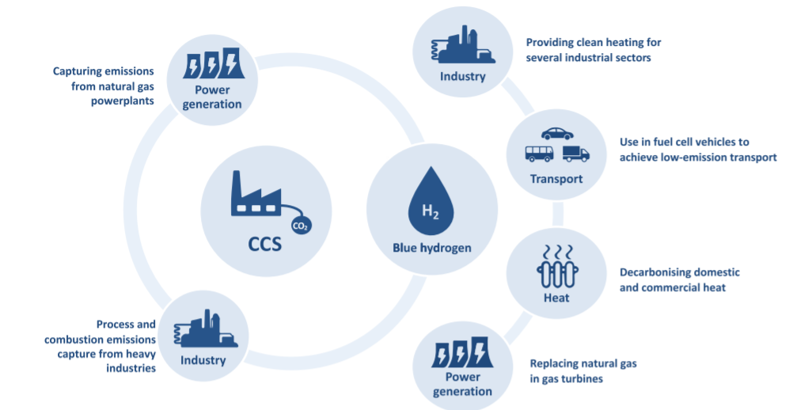
THEMATIC STUDY: Hydrogen and Decarbonisation
In order to achieve the governments ambition to achieve net zero emissions by 2050 we need to further consider the role of the growing hydrogen economy to promote decarbonisation across construction in the South East, that can be effectively utilised during all stages of the project lifecycles through the workforce. Coupled with the potential future transition to green hydrogen, these jobs can be sustained long-term through further skills development.
It is thus paramount to understand the opportunities and benefits it provides for industry and the UK as a whole, beyond wide-scale decarbonisation.

