Slide 1
Bradwell B Update
SELEP Major Projects Skills Webinar – May 2021
Andrew Murdoch and Kate Stinton

Slide 2



Industrial partners for the last 30+ years
58 nuclear units in operation in France and 15 in the UK
Group providing services to 37.1 million customers
Currently has 24 nuclear units in operation
7 units currently under construction
UK’s largest producer of low carbon energy
Holds the world record for 4,400+ days of continuous operation without unplanned shutdowns
Global workforce of over 35,000, including 6,000 engineers
Around one-fifth
of the UK’s electricity from nuclear, wind, coal and gas

Slide 3
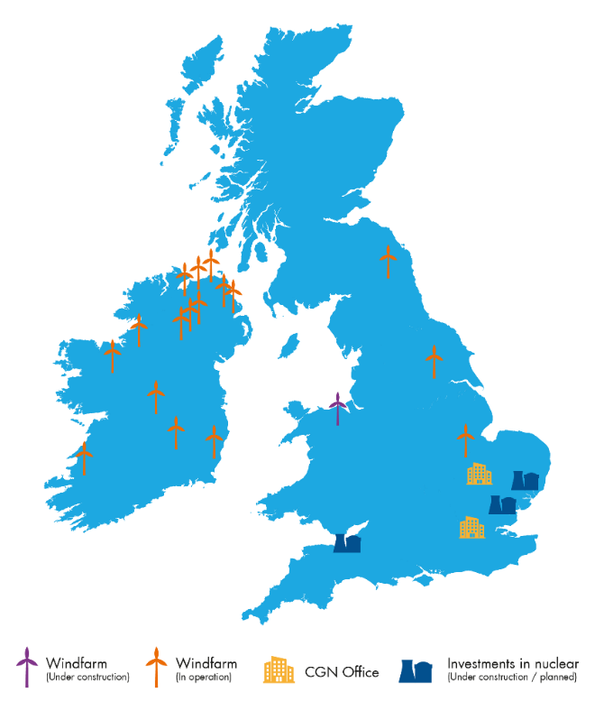
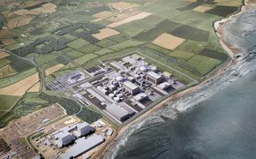
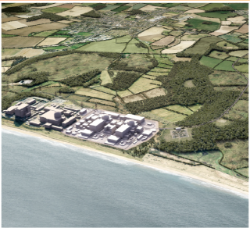
CGN in the UK
CGN UK
CGN’s UK project shareholding
Committed more than £10 billion to UK new nuclear
HPC
SZC
BRB
General Nuclear System
33.5%
20%
66.5%
66.5%
Hinkley Point C (HPC)
Sizewell C (SZC)
Bradwell B (BRB)
CGN Renewables in UK
346MW of onshore wind in operation in Ireland and UK
Also has a small fuel-trading business based in Cambridge
    Technology
    EPR
Status
Construction
    Technology
    EPR
Status
Development
    Technology
    UK HPR1000
Status
Development
©2021 Bradwell Power Generation Company Ltd. All rights Reserved. NOT PROTECTIVELY MARKED.

Slide 4
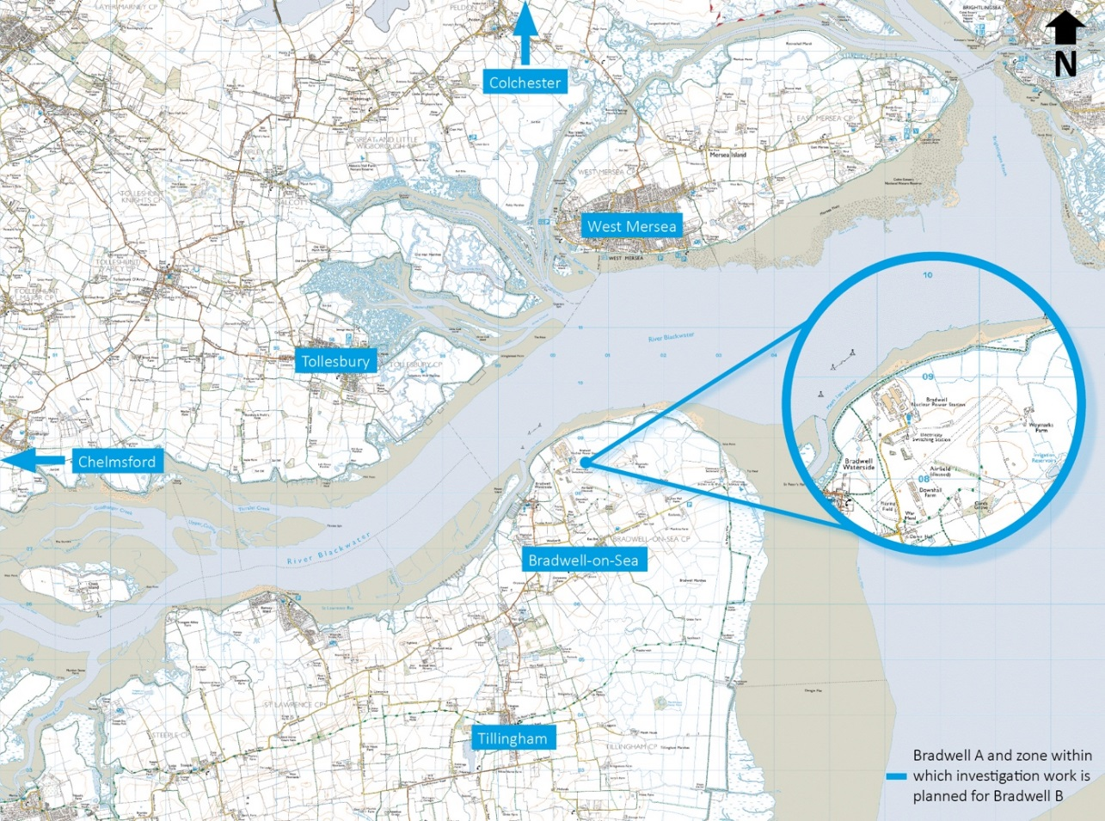
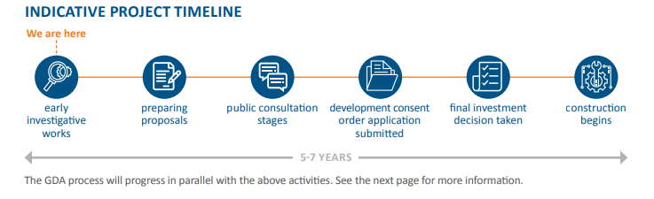
BRB Location and Timeline

Slide 5
Workforce and Skills Development – Four Key Pillars
Creating Economic Benefit - Addressing key national, regional and local priorities and leaving a sustainable legacy
Minimising Workforce Risk – Right skills, right place, right time
Being a ‘Force for Good’ in the Region – Ensuring DCO commitments leverage further investment
Integrating HPC, SZC and BRB Activity – Maximise efficiencies and learn from experience, working closely with the supply chain, to drive productivity

Slide 6
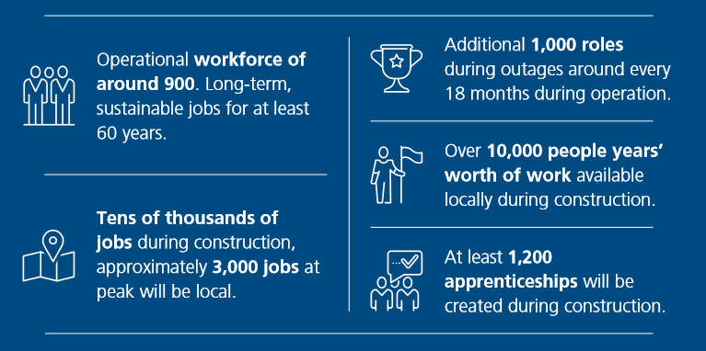
Early Bradwell B Commitments

Slide 7
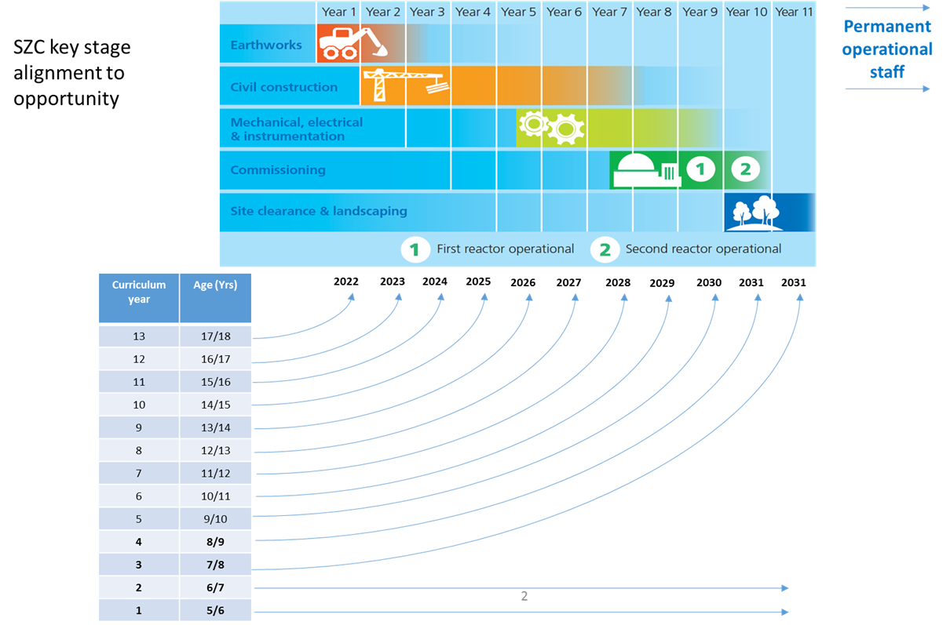
Getting the Timing Right
Generic Project Example: Key Stage Alignment to Opportunity

Slide 8
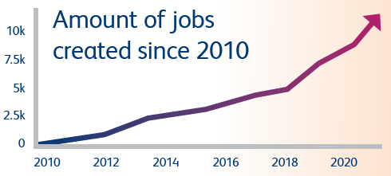

Hinkley Point C: The Experience So Far
11,769 job opportunities
36% of the workforce recruited from the local area
1240 people helped into new jobs by the Hinkley
Jobs Service
756 apprentices
14000 people trained and assessed at Construction Skills and Innovation Centre
1841 members of the workforce who upskilled in classroom-based training in 2020
Total projected jobs to be supported by the project – 71,000
©2021 Bradwell Power Generation Company Ltd. All rights Reserved. NOT PROTECTIVELY MARKED.

Slide 9
What Now for Bradwell B
Develop knowledge transfer from other NNB and UK NSIP projects
Further develop Skills and Education strategy together with Essex
Education Outreach – develop proposals with partners
Delivering Bradwell B in Partnership
©2021 Bradwell Power Generation Company Ltd. All rights Reserved. NOT PROTECTIVELY MARKED.

