Slide 1
London Resort Employment and skills SELEP Major Projects skills webinar

Slide 2
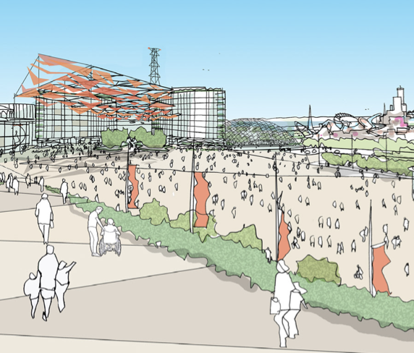
London Resort
London Resort Company Holdings is proposing to develop a world-class, sustainable, next generation entertainment resort on the banks of the River Thames.

Slide 3
Vision
Unique, immersive world-class destination
Sustainable and environmentally-responsible
Our Partners
Harnessing natural landscape and riverside location
Innovative, relevant, flexible
A catalyst for job creation and regeneration

Slide 4
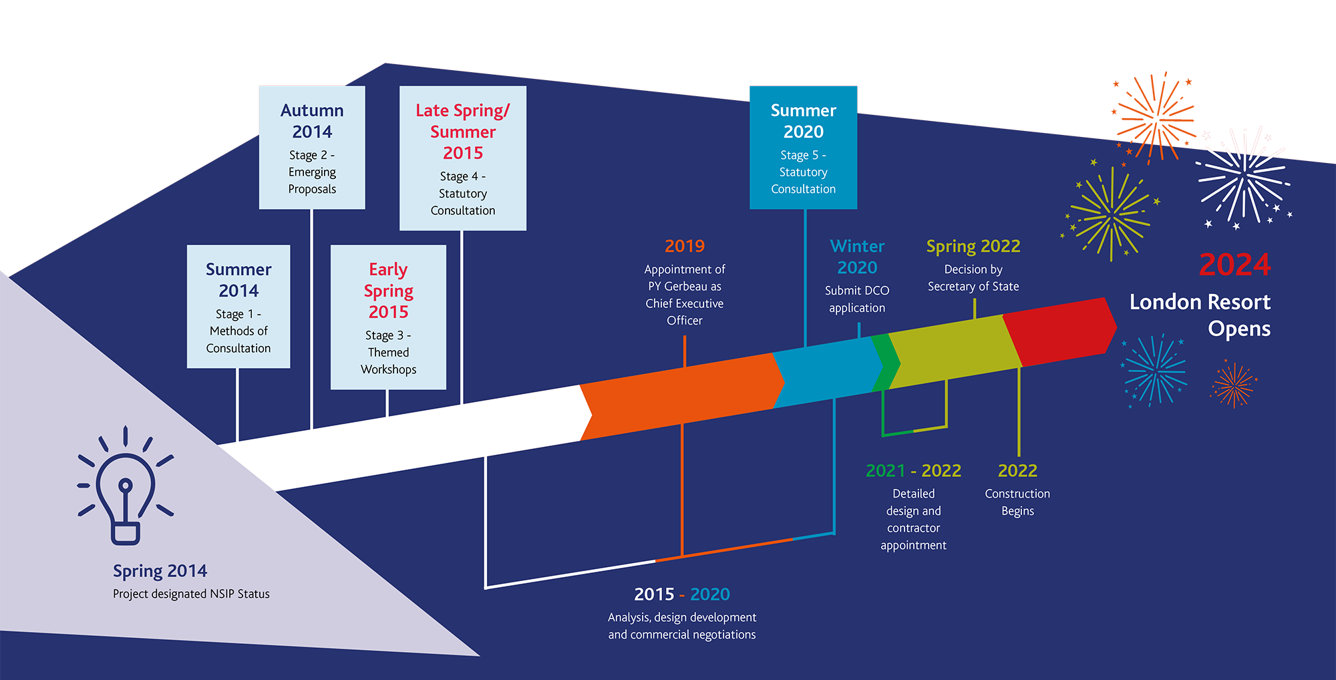
Story so far
Winter
2020
DCO application
submitted

Slide 5
Project overview
New Entertainment Resort founded on sustainable and low-carbon principles
Key features include:
Two theme park gates, to be opened in phases – 2024 and by 2029
Hotels, retail, dining and entertainment - more entertainment, eSports, Conferention Centre, Water park
Operational housing
Transport interchanges for rail, coach, ferry, taxis, cars and visitors
Park and Glide at Tilbury
Access road and main junction with A2(T)
Car parking, utility compounds, renewable energy sources
A top 20 global theme park with attendance of 12.5 million

Slide 6
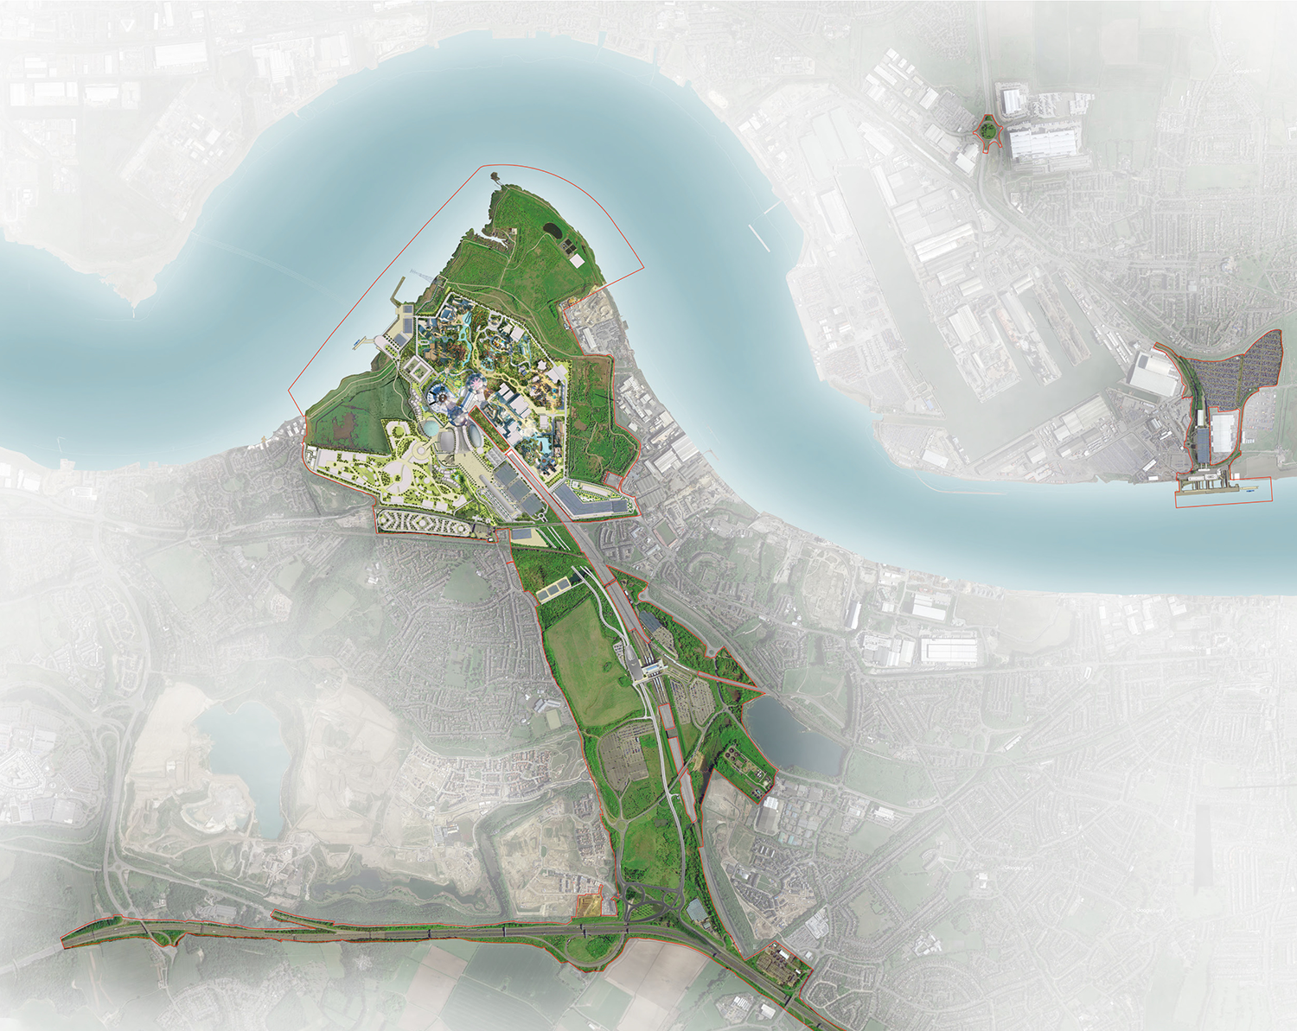
Masterplan
illustrative

Slide 7
Identified employment and skills issues
Relatively high unemployment
Pockets of deprivation
Relatively low qualifications
Low productivity
Lack of vocational opportunities
Low employment indicators for some under-represented groups (women, ethnic minorities, 16-24 YOs)

Slide 8
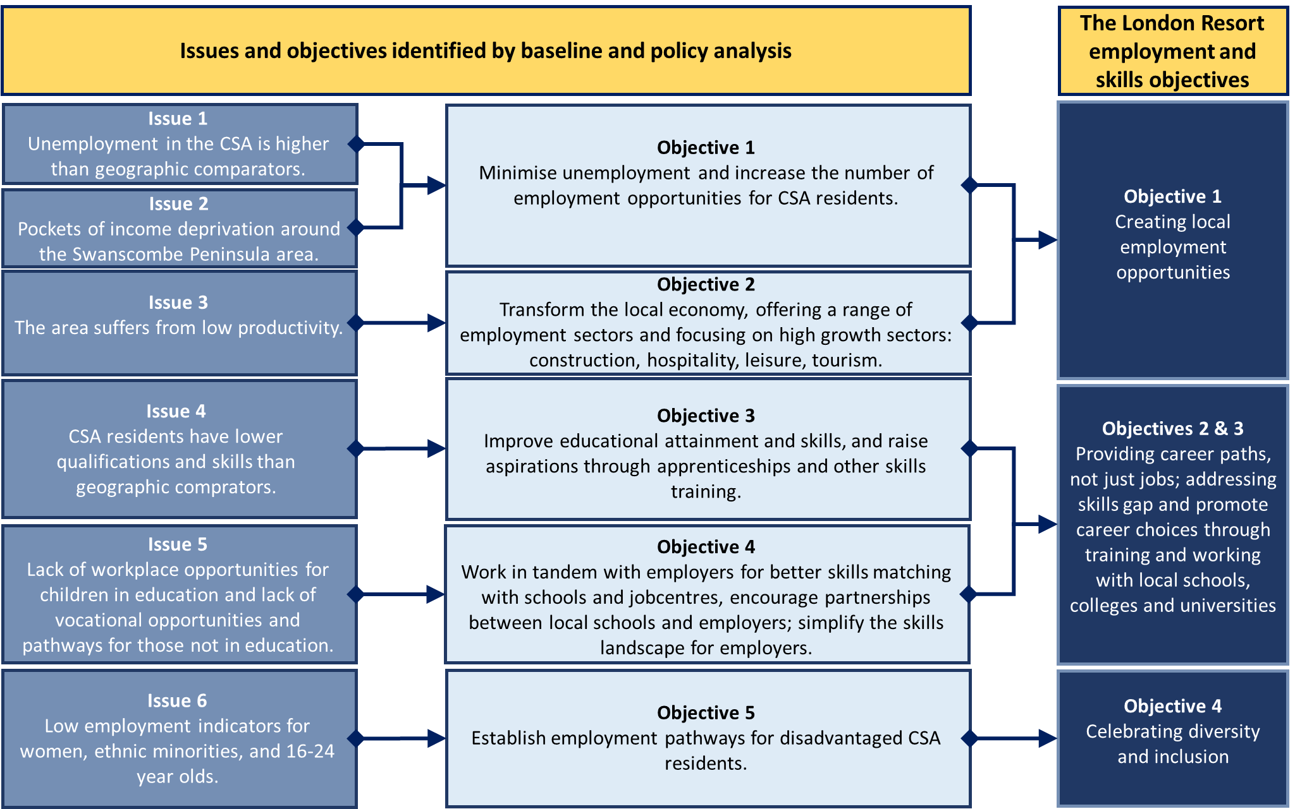
Issues, policy and objectives

Slide 9
London Resort Employment and skills objectives
Creating local employment opportunities
Providing career paths, not just jobs
Addressing skills gaps and promoting career choices through training and working with local schools, colleges and universities
Celebrating diversity and inclusion

Slide 10
Construction jobs
 |  | Phase One |  | Phase Two
 |  | Low | High | Low | High
Onsite job years | Total | 6,600 | 9,900 | 2,700 | 4,100
 | Average per year | 2,600 | 4,000 | 900 | 1,400
 | Peak (year) | 3,300 | 5,000 | 1,100 | 1,700
Offsite job years | Total | 9,900 | 6,600 | 4,100 | 2,700
 | Average per year | 4,000 | 2,600 | 1,400 | 900
 | Peak (year) | 5,000 | 3,300 | 1,700 | 1,100
Total job years | Total | 16,500 |  | 6,800
 | Average per year | 6,600 |  | 2,300
 | Peak (year) | 8,300 |  | 2,800
Total 23,300 job years supported by construction
Considerable specialist offsite construction envisaged
Temporary workforce & associated accommodation anticipated

Slide 11
Direct operational jobs
One of the largest single site employers in the UK
Majority of the jobs created (69%) will be at the theme park
Of all the seasonal workers, 91% will be based at the theme park
Job types and roles
A large share of the jobs on offer (>70%) would have low formal entry requirements, improving access for local residents
The diversity of jobs on offer would help transform the local economy, with wide selection of jobs to choose from and broad range of careers
Significant progression opportunities would be available
A large number of jobs would be in the knowledge economy (from accountants, IT workers, legal professionals through engineers and marketing specialists), increasing productivity and creating high skill clusters
2024 |  | 2030 |  | 2038
Headcount | Seasonal | Headcount | Seasonal | Headcount | Seasonal
8,810 | 3,230 | 13,010 | 4,835 | 17,310 | 7,080

Slide 12
Employment and skills - implementation
We have an Employment & Skills Taskforce, recognising the importance of communication with all relevant stakeholders - local authorities, EDC, SELEP, education and training providers, job centres
We have been developing a series of potential KPIs, which include targets around: Apprenticeships, supply chain, school engagement, retention, career progression, opportunities for local people and priority groups.
5% of all construction opportunities to be ‘earn & learn’ roles
Operational workforce to achieve 15 apprenticeship starts per 1,000 workers
Work experience placements, employee encounters, workplace experiences
Become an Employer of Choice for under 25s, strategy endorsed by industry bodies

Slide 13
Identifying & responding to skills gaps (examples)
Hospitality & Creative industries identified issues:
Poor perception of the industry – inspire young people & new entrants
High staff turnover – develop a retention plan & promote careers
Skills and training lags employer needs – develop targeted programmes. E.g. Chef shortage, front of house & managerial staff. Train staff with soft skills onsite.
Prominence of freelancers (creative) – provide targeted support to SMEs

Slide 14
Employment and skills - monitoring
We will produce regular monitoring reports and accompanying strategies. These include:
School engagement plan
Vulnerable Groups prioritisation
Supply Chain Engagement Strategy
Skills Shortages identification
Retention Plan

Slide 15
Find out more:
PINS: The London Resort | National Infrastructure Planning (planninginspectorate.gov.uk)
London Resort website: Welcome to The London Resort
Sign up for updates: Stay in touch - London Resort

Slide 16
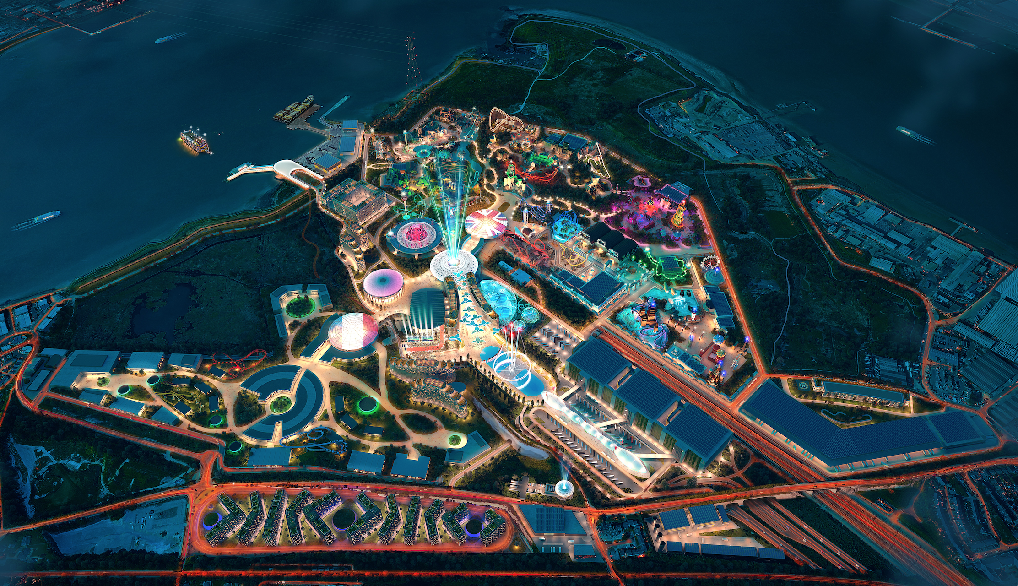
Thank you for listening

