Slide 1
Governance and Transparency:
Recommendations for Approval
Adam Bryan
Managing Director
Strategic Board
16th March 2018

Slide 2
1 of 8
Recommendation | Adopt the refreshed Terms of Reference
Remarks | Minor changes to existing ToR only See Appendix A
Decision required | Yes

Slide 3
2 of 8
Recommendation | Agree LEP oversight role in recruitment to federated boards
Remarks | Consistent approach adopted Reports to subsequent SELEP board meetings
Decision required | Yes

Slide 4
3 of 8
Recommendation | Reaffirm support for the Investment Panel
Remarks | Already agreed No impact on role of extant boards Clear requirements from Government Terms of Reference to be issued
Decision required | Yes

Slide 5
4 of 8
Recommendation | Agree to develop a single pipeline of projects to draw upon when underspends, slippages or opportunities emerge
Remarks | Clear requirement from Government Planned within Infrastructure and Investment Plan anyway
Decision required | Yes

Slide 6
5 of 8
Recommendation | Agree a standard approach to calls for projects when funding is available
Remarks | Requires consistency around SELEP and federated area websites
Decision required | Yes

Slide 7
6 of 8
Recommendation | Formalise the board induction process
Remarks | Induction processes at federated level already happen and often include SELEP SELEP pre-briefing approach Just need to articulate and publish
Decision required | Yes

Slide 8
7 of 8
Recommendation | Discuss the introduction of time bound tenures for board membership
Remarks | Succession planning highlighted as a concern Need agreement from all federated boards
Decision required | No

Slide 9
8 of 8
Recommendation | Provide transparency around Gifts and Hospitality
Remarks | Approach detailed on the website Easy to implement
Decision required | No

Slide 10
Growth Hub: Strategic Board Engagement
Suzanne Bennett (SELEP), Jacqui Ward (KCC), Graham Marley (LDBG), Murray Foster (BEST Business Rep)
SELEP Strategic Board
16th March 2018

Slide 11
Introduction & Scene Setting
September 2017 Strategic Board update
Update on current funding position
BEIS commitment to policy
Principles of Funding
Activity plan for 2018/19
Presenters today
What we would like to hear
Next steps

Slide 12

Operational Model with Scrutiny Function
South East Business Hub Steering Group
Business Essex, Southend & Thurrock GH
Local Steering Group
Kent & Medway GH
Business East Sussex GH
Local Steering Group
Local Steering Group
SELEP STRATEGIC BOARD
Notes:
This model is a response to our large geography, our hub and spoke model and steering group ensures that we can offer both pan-lep activities and also more tailored support required at a very local level.
Scrutiny at local level and LEP wide via steering groups

Slide 13
Jacqui Ward
Kent County Council

Slide 14
How this operates in Kent
Meeting the Needs of Businesses
  Feedback from Businesses
  Engagement of stakeholders
  Marketing / Promotion
Developments for the Future
  Higher Growth Businesses
  National Promotion of Growth Hubs
Key challenges
  Access to Finance
  Access to Training and Apprenticeships
Notes:
To provide an overview of the Kent model – from a contract holder perspective and how you see it linking with other areas

Slide 15
Graham Marley
Let’s Do Business Group

Slide 16
Provider Focus: East Sussex
What we do and how we got there
Case Study
Key challenges
Notes:
To provide an overview of the Kent model – from a contract holder perspective and how you see it linking with other areas

Slide 17
Murray Foster
BEST Business Rep

Slide 18
The Business Voice Shaping the Service
BEST Steering Group
Local Authority Economic Development Representatives
Business Representatives
Universities
Better Business for All
SELEP
4 x EDO representatives 1 from each quadrant
Essex Chambers of Commerce and Federation of Small Business
Essex Federated Board Representatives
Essex County Council

Slide 19
Group Discussion

Slide 20
Capital Programme Management Update
Rhiannon Mort
SELEP Capital Programme Manager
Strategic Board
16th March 2018

Slide 21
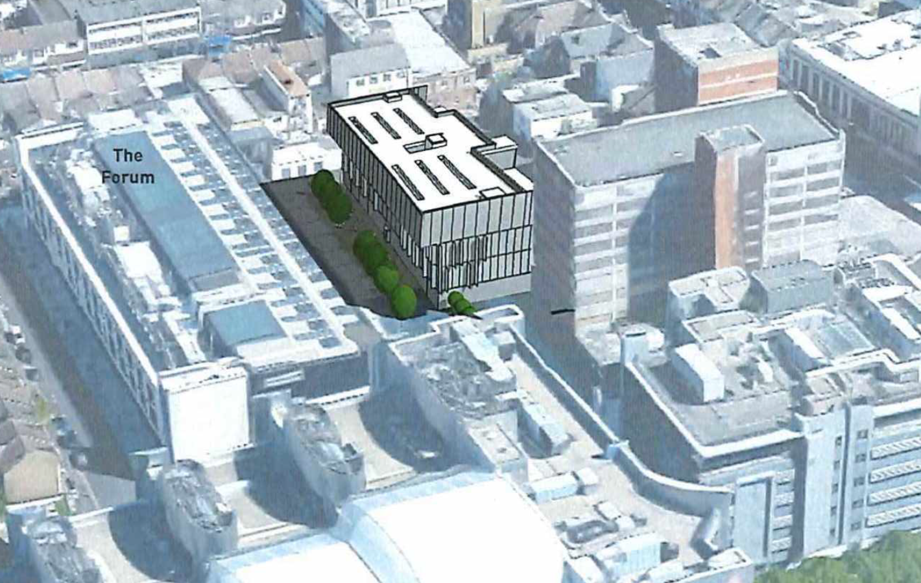

Summary Position
Forum 2 Southend
£6m LGF allocation
North Bexhill Access Road
£18.6m LGF allocation

Slide 22
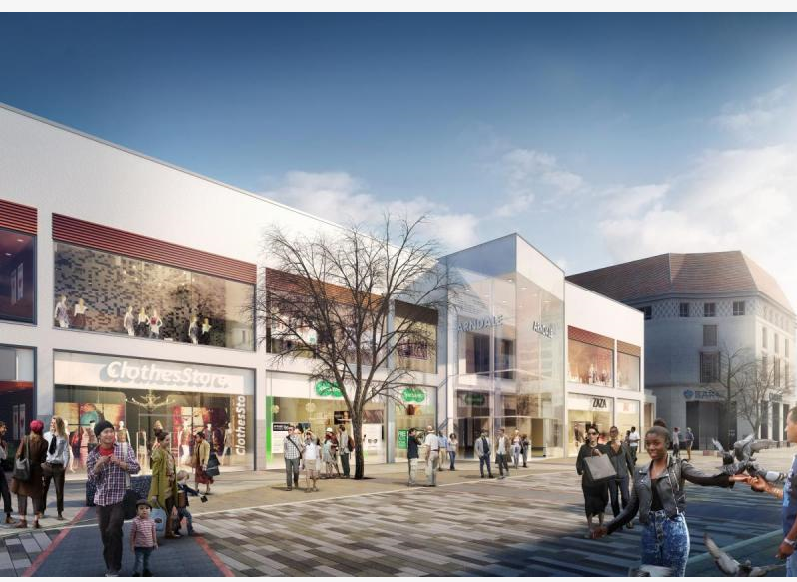
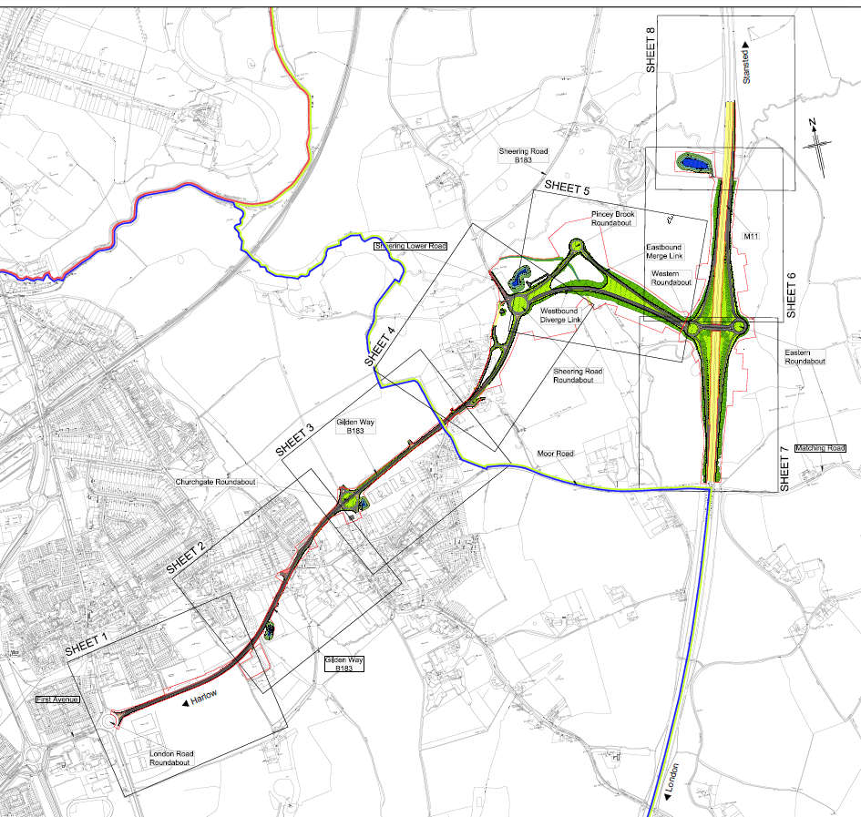
Eastbourne Town Centre
£8m LGF allocation
Gilden Way
£5m LGF allocation

Slide 23
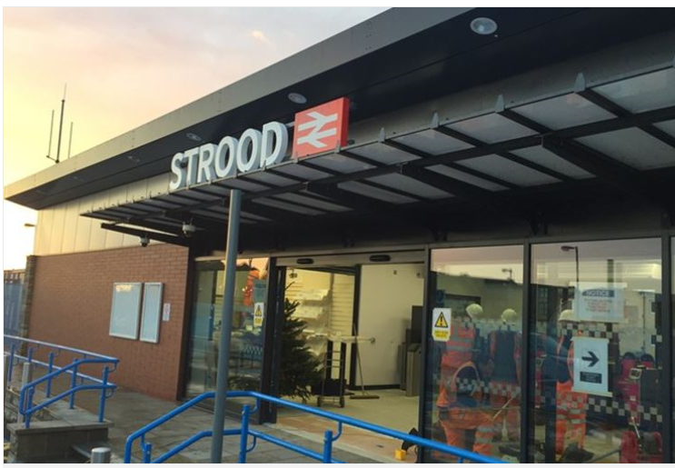
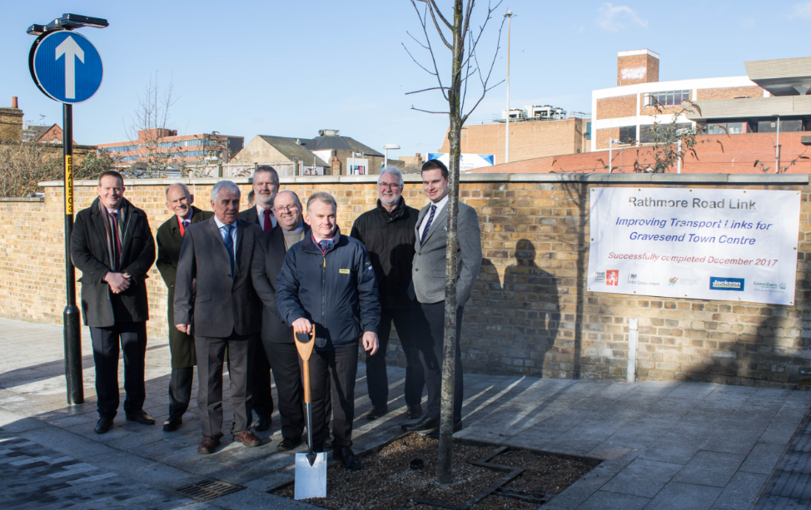
Strood Town Centre
£9m LGF allocation
Rathmore Road Link - £4.2m LGF allocation

Slide 24
LGF funding awards
LGF funding awards 23rd February 2018
Chelmsford City Growth Area Scheme LGF funding decision (£10.0m)
Gilden Way Upgrades (£5.0m)
Kent Strategic Congestion Management Programme 2018/19 (£1.0m)
Kent Sustainable Interventions Programme 2018/19 (£0.5m)
Southend Forum Phase 2 (£6.0m)
Hasting and Bexhill Movement and Access Package (£6.0m)
A289 Four Elms Roundabout (£3.5m)
LGF funding awards 16th March 2018
- Strood Civic Centre Flood Mitigation (£3.5m)

Slide 25
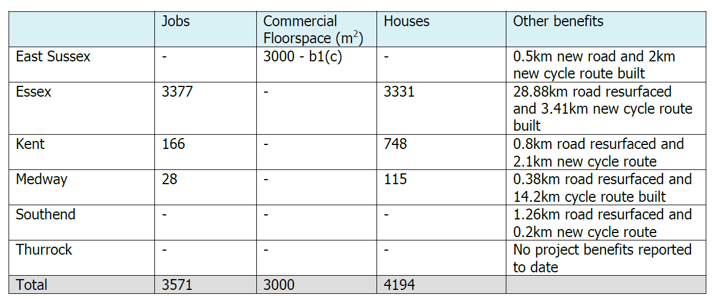
LGF outputs and outcomes

Slide 26
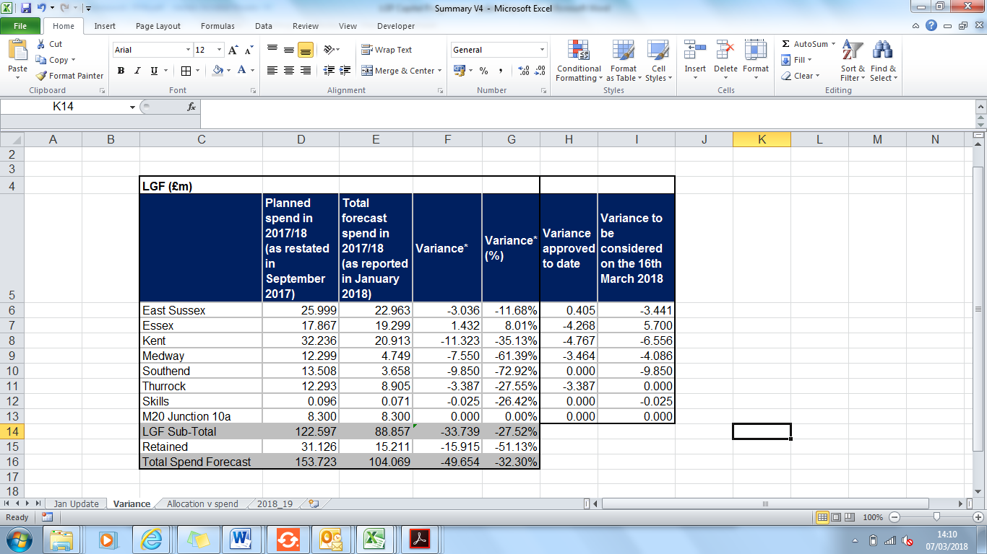
2017/18 financial update

Slide 27
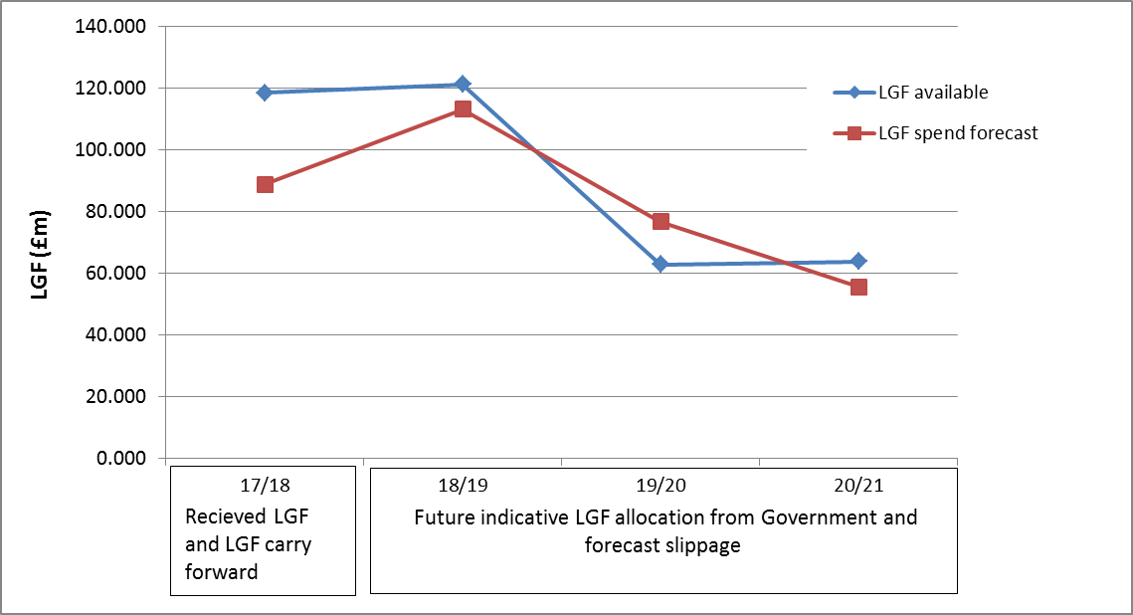
LGF profile

Slide 28
Principles
Principle 1 - All projects identified in the LGF programme which have not been approved by the Accountability Board to date must come forward with a business case which can demonstrate deliverability and for a funding decision by the Accountability Board by the end of 2018 calendar year. The final meeting for these projects to be considered is the Accountability Board meeting on the 16th November 2018.
Principle 2 - If projects are unable to come forward for the award of funding by the Accountability Board meeting by the 16th November 2018, then recommendations will be made to the Strategic Board on the 7th December 2018 for the re-allocation of funding.
Principle 3 - The Board will be asked to endorse the prioritisation of the LGF underspend following the approach to be agreed by the Board at its meeting on the 29th June 2018. The promoting authority will have the opportunity to make the case to the Board for the re-allocation of funding to alternative project(s) prioritised by the Federated Boards which can demonstrate delivery by the end of the Growth Deal period.

Slide 29
LGF pipeline development
Reasons for refreshing SELEPs pipeline:
Response to recommendations by Government
Management of LGF underspend
Allocating the £8.3m LGF which is currently unallocated
Put us in a strong position to respond to future calls for funding eg. Shared Prosperity Fund
Approach:
Use LGF Round 3 unsuccessful projects as a starting point but needs to be reviewed in light of emerging priorities and new projects which have come forward
Detail of the approach to be brought to next meeting on 29th June 2018

Slide 30
2018/19 planned LGF spend

Slide 31
GPF update (Round 2 projects)
Scheme name | Federated Area | Total GPF (£) | Approval by the Accountability Board
Colchester Northern Gateway | Essex | 2,000,000 | Approved
Eastbourne Fishermen | East Sussex | 1,150,000 | Approved
Centre for Advanced Automotive and Process Engineering | South Essex | 2,000,000 | Approved
Fitted Rigging House | KMEP | 800,000 | To come forward in 2018/19
Innovation Park Medway | KMEP | 650,000 | To come forward in 2018/19
NUE Commercial | KMEP | 1,000,000 | Approved
Charleston Centenary | East Sussex | 120,000 | Approved
Javelin Way Development | KMEP | 1,597,000 | To come forward in 2018/19
GPF total |  | 9,317,000

