Slide 1
Who are we? Merged 29th March 2018
Notes:
The brief from Graham is as follows
5-10 mins on ESCG, how we got there and what it will do for East Sussex
15-20 mins – what ESCG is already doing or could do in terms of growth and support to businesses and stakeholders with specific reference to the 5 growth sectors:
Construction
Care
Engineering and Manufacturing
Land based and the visitor economy
Creative and Digital

Slide 2
Supporting innovation in East Sussex’s five growth sectors:
Construction
Care
Engineering & manufacturing
Land-based and the visitor economy
Creative & digital
Notes:
The brief from Graham is as follows
5-10 mins on ESCG, how we got there and what it will do for East Sussex
15-20 mins – what ESCG is already doing or could do in terms of growth and support to businesses and stakeholders with specific reference to the 5 growth sectors:
Construction
Care
Engineering and Manufacturing
Land based and the visitor economy
Creative and Digital

Slide 3
East Sussex College Group
Formed by merger of Sussex Coast and Sussex Downs Colleges
Largest FE / HE college in East Sussex - 18,000 students
Committed to engaging with and responding to local employer current and future skills needs
Notes:
Formed by merger of Sussex Coast and Sussex Downs Colleges on 28th March 2018
Largest Further Education College in East Sussex with 18,000 students annually studying anything from pottery to BA/BSc
Focused upon the needs of the county for growth and skills

Slide 4
East Sussex College Group -
our vision…
Standards
The Group will target improvement in standards across East Sussex so they meet and exceed the South East and national averages.
Strategic partnerships
The Group will work closely with our partners to:
Open up new opportunities for co-operation and co-working
Maximise learning, skills development and progression for East Sussex communities
Sustainability
The Group will manage resources to the highest standards, to benefit students and maximise their learning, progress and achievement.

Slide 5
A senior team to support East Sussex growth
Three Principals driving curriculum & standards at L, EB, NH and H
Executive Director of Strategic Partnerships & Engagement
Director Sussex Skills Solutions – skills solutions for business and apprenticeships
Head of Higher Education – broadening HE to meet local sills need
Head of Innovation and Commercial – R+D to meet more local skills needs
Head of Partnerships – co-commission training with partners to meet local skills needs
Notes:
I thought it was helpful to outline the senior structure and the next two slides to showcase how we can improve standards and innovate to meet local need….

Slide 6
A senior team to support East Sussex growth
Executive Director of Resources
Chief Financial Officer
Develop an ambitious capital investment programme for skills dev, across the county. County, Boroughs, Districts, LEPs
Developing, financing and delivering a new estate for Eastbourne and Lewes
Exploring mixed use models to include housing and business space

Slide 7
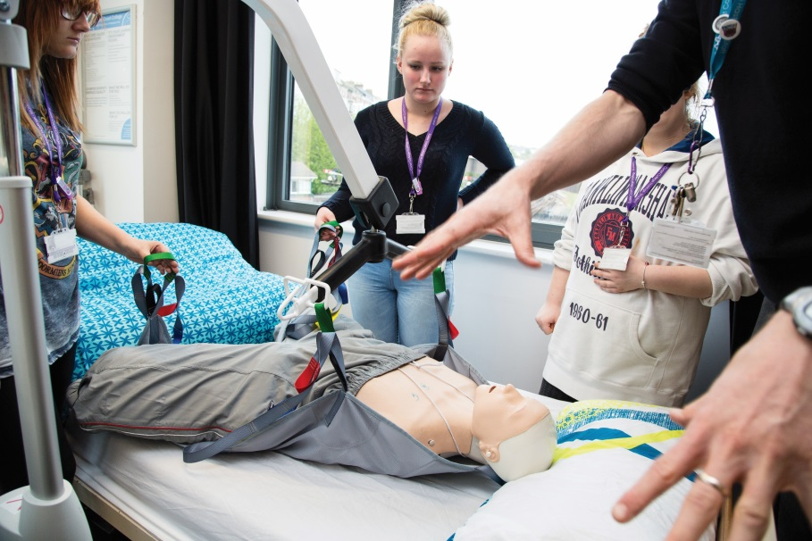
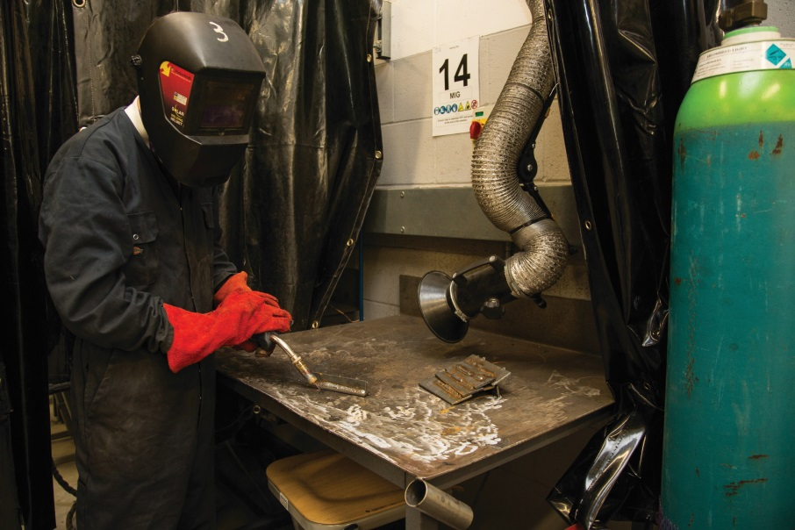
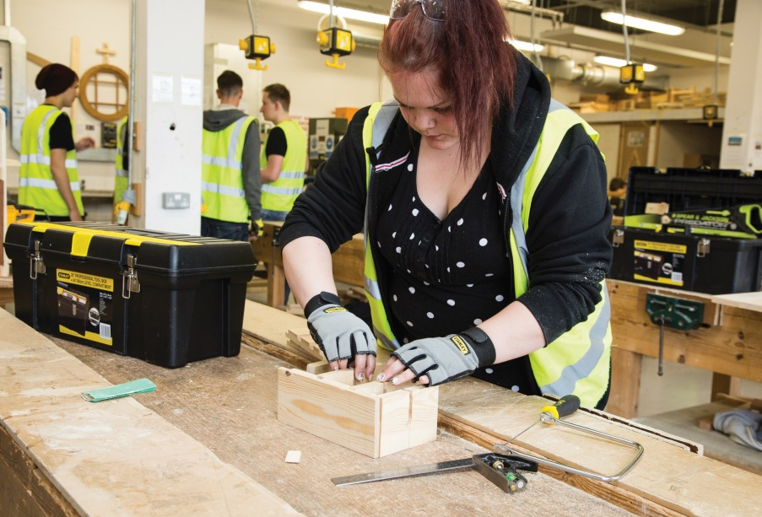
Growth sectors – what we’re doing now
Notes:
This is the Segway between the two sections of the presentation where I will now go onto what the Group is already doing and what it could do within the 5 growth sectors…

Slide 8
Construction & Built Environment
new curriculum with DES & SES
Construction Design & Engineering (prof)
Construction Management (prof)
Civil Engineering (prof)
Modular and Sustainable Building Methods (prof)
Developing pathways to Degrees & Degree Apprenticeships with UoB
Eastbourne & Lewes LA partnership - S106 apprenticeships & placements
Notes:
Developers East Sussex (DES) – a regular meeting of the main local developers in the county and Skills East Sussex (SES) Construction employers group
This new curriculum is increasing the range of technical and professional skills within the sector whilst retaining the trade element which we have a strong range of provision in already.
The provision above feeds the UoB revised programme in CBE
Building Partnerships is the programme that Clare W-T is working up with Eastbourne BC. They will fund a staff member to grow the range of placements and apprenticeships that are delivered on any new build which will benefit us in terms of income and study programmes providing meaningful work placements.
S106 = Section 106 which agreements between Local Authorities and developers of sites that provide funding for things like public realm (parks, gardens or public pieces of art) in/around new developments and this includes commitments (either additional funding to develop them or actual starts) for apprenticeships and/or work placements etc. so basically it is additional contributions from developers on key social or economic things that add value to the building development.

Slide 9
Care
Wide range of provision, all ages, up to Degree
Access courses - supporting 150 adults to progress to Health based degrees annually
Developing e-learning modules for peripatetic care workers:
Maths linked to dosages
Dementia care training
With CCG developed health & well being programmes for targeted groups, e.g. confidence building for people with mental health conditions
Keen to develop innovative approaches ageing population, eg apps for the elderly
Notes:
I think it is worth pointing out that the Access programme is there for adults that have missed the opportunity to gain quals that enable them to progress to university, especially in this sector which has falling numbers of applicants for those HE programmes.
We are developing e-learning modules that we can fund via AEB – these are aimed at lower skilled workers to upskill them.
The targeted groups are older people and those adults with mental health issues. CCG = Clinical Commissioning Groups
The final bullet point is linked to a key aim of Graham Peters – to set something up in East Sussex that is world class and market leading. University of Sussex have a Centre for Innovation and Research in Wellbeing which focuses upon Ageing, health, mental health, children and migration and I think we could work with them and others to set up something in the county that develops new programmes (and potentially products to aid professionals in this area but also the residents themselves to age well!)

Slide 10
Digital & Creative
Orgs co-locating at our colleges, eg Tech Resort at EB
Growing computing provision up to BSc focused upon networking and systems design
Emerging industry - cyber security
Share & protect data
The majority of HE is creative
Undergraduates – work for you
Qualified – your people!
Notes:
TechResort is a social enterprise that provides a range of services including provision aimed at 8 to 18 year olds providing them with the opportunity to code, make and explore – they are in essence a digital training organisation for young people.
Again this is a nod to Graham – could we look as part of the estates strategy to provide incubator space for SMEs so that we co-create programmes etc?
The programmes we offer are mainly focused upon the back end e.g. website development, servers and systems rather than how to use Word etc – although we do these too!
The final bullet relates to our 150 art and design HE Students… could we link better with businesses who cannot afford creative support and link this into their programmes… this could equally apply to FE students too and we could set up a design studio where student gain work experience on live (and paid for but at low cost) projects e.g. websites, leaflets or marketing campaigns.

Slide 11
Manufacturing & Engineering
Wide range of programmes up to BSc (Hastings)
Innovative short courses
Vacuum technology
Lean techniques developed with employers
Funding to set up spaces near employers in Hastings
Keen to expand specialisms to meet future growth, e.g. robotics
Notes:
Our HE in this area is all in Hastings and is likely to remain there.
We have develop a number of short courses with employers…. The vacuum course has had over 200 students on in it in 3 to 4 years (30 hours per course) and Lean techniques refers to a new course being developed that helps firms look at every stage of production with the view to taking out any small snags in the processes therefore speeding up that production/productivity of the business etc.
The third bullet point is linked to some ESF funding called Community Led Local Development (CLLD) and we are working with Marshall Tufflex and other firms to develop a small training space so that workers on that estate can participate in training courses immediately next to their workplace. This could also become a research and test bed centre which would be exciting….
Final point is again looking to the future. SDC have run some robotics modules but we would need investment in the kit so again another potential opportunity for the estates reshape… and again is a nod to the idea of getting ES known for something other than winemaking (like the ageing example on the care slide).

Slide 12
The visitor economy
Extensive and traditional hospitality & catering provision
Canteen – fine dining
Want to modernise this
Sector training, eg hotel school
Notes:
This is actually Landbased and Visitor economy as a target growth sector but as Plumpton are working on the former part we should be working on the latter! Might be worth name checking Plumpton with this point? (Jeremy is likely to be there presenting too)
Our offer is much more traditional here – mainly front and back of house hospitality
But I have flagged the fact that all SCC students get to train in different settings in-house
We have a L4 C&G Hospitality Management course in Hastings (as an apprenticeship) but this is small
Eastbourne Borough Council have been exploring setting up a hotel school and SDC are included in the thinking but it has stalled – I think we need to state that we would be interested in doing something different like this hence the last bullet….

Slide 13
Wider planning with partners David Smith

Slide 14
East Sussex – integrating public benefit planning beyond city regions
A potential case study in new approaches to education and skills investment

Slide 15
East Sussex College Group attracts national interest
Transaction Unit: full and ‘first time’ support (loan and grant = £12 million)
Merger process completed in 8 months (July 2017 to March 2018)
Commendation for the development of ‘collaboratively planned’, comprehensive Estates Strategy by July 2019
‘Group Prospectus’ by September 2019

Slide 16
The attraction of ‘East Sussexness’
Gestation of ESCG through Transition Board – primary input ESCC, SELEP and UoB on design and development
Secondary dialogues: C2C, UoSx, colleges, boroughs and districts
Creates a foundation document on ESCG Vision and Ambitions that pledges:
“ A detailed capital education and skills investment plan, collaboratively designed…” (Estates Strategy AND Group Prospectus)

Slide 17
BUT collaboration ‘costs’….
Layers of engagement; eg Eastbourne Borough/Lewes District/ESCG ambitious joint planning on ‘sale and regeneration’ across Lewes, Eastbourne and Newhaven
Requires alignment with SELEP and C2C economic and skills ambitions AND housing and public amenity requirements AND transport and infrastructure commitments…and community/ partner organisation (UoB/UoSx) aspirations…
City Regions have bespoke support and attract ‘extra’ resource to integrate and co-ordinate

Slide 18
So, an ambitious rural/coastal county with all relevant partners engaged….?
Seek funding support, as a ‘case study’ for an integrated approach to capital AND revenue ‘skills planning and investment’?
Gatsby Foundation http://www.gatsby.org.uk/education/about/applying-for-support
ESCG to explore, with support of Team East Sussex and key partners the potential for a case study ‘beyond City Regions and Combined Authorities’ (see Gatsby guidance on Applying for Support)
Timescale: Summer 2018 explore/apply; project runs Sept 2018 to June 2019; outputs (collaborative capital plan and group prospectus July 2019

Slide 19
We’d love to hear your ideas……
Open to new ideas and partnerships to better meet skills needs
Very keen to work with partners and stakeholders
We have the structure to engage and innovate
Our estates strategy provides opportunities to explore innovative models of delivery, co-location of businesses, research and development and housing
Notes:
I think these are self explanatory but enable the discussion to open up after this slide

Slide 20
Questions, comments and ideas?
Dan Shelley, Director of Strategic Partnerships & Engagement
dshelley@sussexcoast.ac.uk or 07879 406892

